Slide 1
Pulmonary Function Test
Spirometry

Slide 2
Spirometry
It is the simplest and most frequently used method to meausre pulmonary function in human, it is a measure of lung volume against time
Spirometer measures the volume and flow rate of forcefully expired air after deep breath

Slide 3
1) Diagnosis of
Obstructive pulmonary diseases (bronchial asthma)
Restrictive pulmonary disease (pulmonary fibrosis)
2) Follow up of patients

Slide 4
Spirometery
Method used for measurement of spirometric parameters.
FEV1(Forced expiratory volume in the first second):Is the volume of air expired forcefully in the first second after maximum inspiration
FVC (forced vital capacity): Is the maximum volume of air expired forcefully after maximum inspiration,
FEV1
FEV1% = -------- × 100
FVC

Slide 5
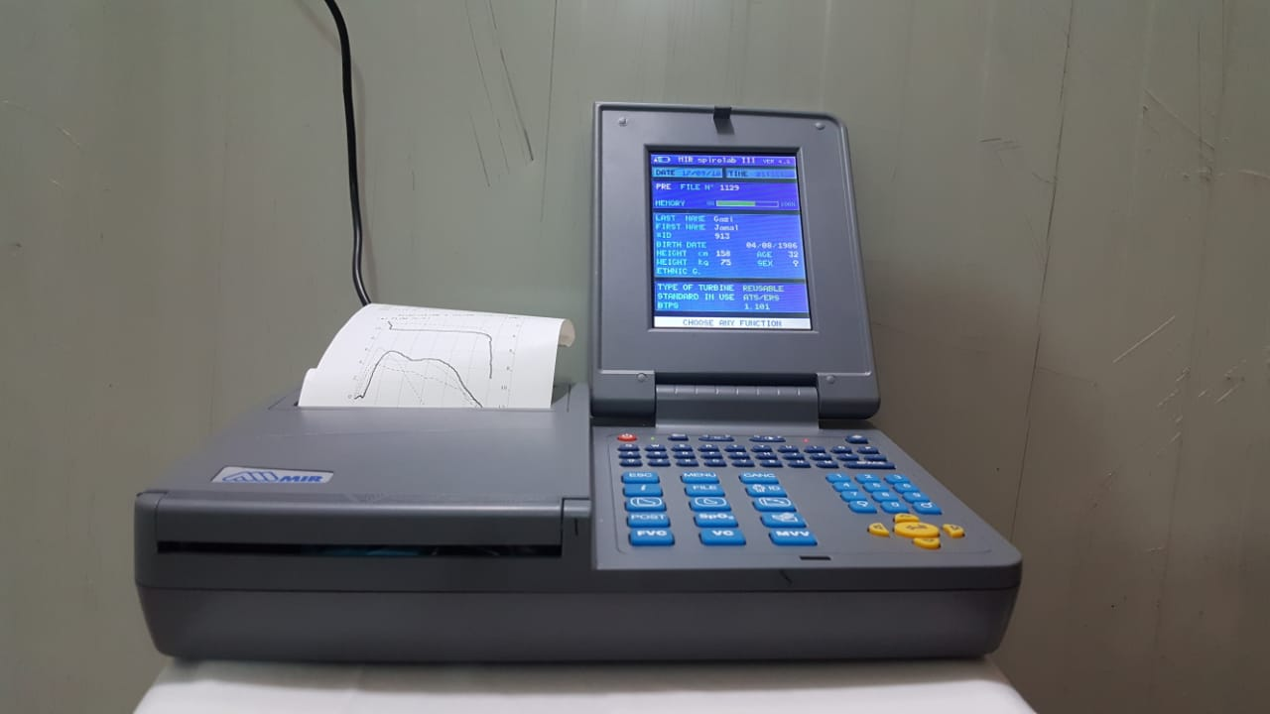

Slide 6
Procedure of spirometry
Spirometry test usually required 15 minutes in especial quite room.
Spirometry done in sitting position after a resting period of 10-15 minutes.
Spirometer turns on to keep its temperature at room temperature.
Personal data (age, sex, date of birth height, body weight, and ethnicity) are entered through spirometer keyboard.
A new disposable mouthpiece is inserted into mini flow-meter mouthpiece holder.
A nasal clip is putted on person nose to ensure that all air is expired into the spirometer.
Instructed the person to take maximum deep inhalation then expel the air forcefully and as fast as possible into mini flow-meter mouthpiece holder of spirometer.
The test is repeated three times and the best results is recorded (International American Thoracic society ATS and European respiratory society ERS).

Slide 7
Find out FEV1%
FEV1
FEV1% = -------- × 100
FVC
In normal subject the FEV1/FEV% >70
Find out FVC%
Measured FVC
FVC%= --------------------- × 100
Predicted FVC
In normal subject FVC% ≥ 80%

Slide 8
Restrictive pulmonary disease
is considered when FVC% is < 80% and FEV1/FVC is normal (>70%)
Obstructive pulmonary disease is considered when FVC% is normal (>80%) and FEV1/FVC is reduced to <70%
Combined (restrictive and obstructive) pulmonary disease is considered when both FVC% and FEV1/FVC are reduced

Slide 9
FEV1%
FVC%
Condition
Normal
Normal
Normal
Reduced
Normal
Obstructive
Normal
Reduced
Restrictive
Reduced
Reduced
Combined

Slide 10
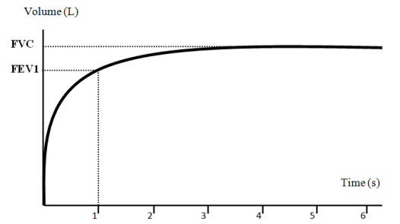
Normal spirogram

Slide 11
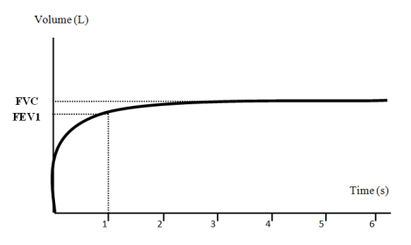
restrictive pattern of spirogram

Slide 12
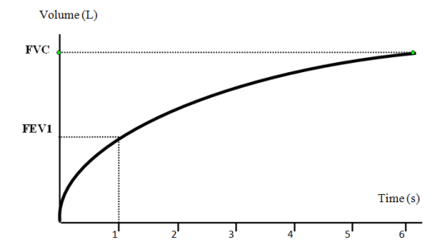
obstructive pattern of spirogram

Slide 13
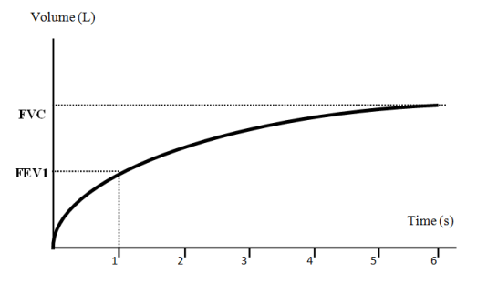
combined (restrictive and obstructive) pattern of spirogram

Slide 14
Factors affecting lung volumes
Age
Gender
Height and built
posture
Ethnic group
Lung diseases (obstructive and restrictive lung diseases)

